Slide 2
Can you name some addictions?

Slide 3
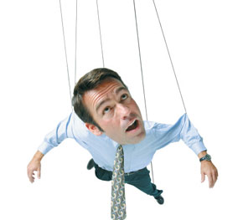
Definition of Addiction
Webster’s Dictionary:
a strong and harmful need to regularly have something (such as a drug) or do something (such as gamble)
A habit that controls you

Slide 4
2 Types of Addiction
Substance
&
Behavioral

Slide 5
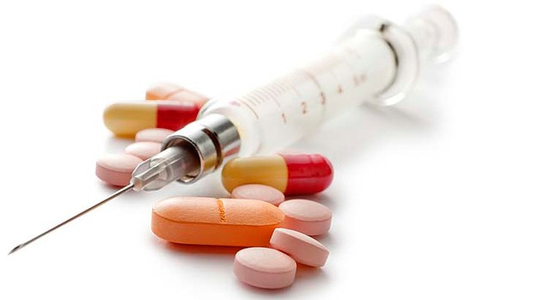
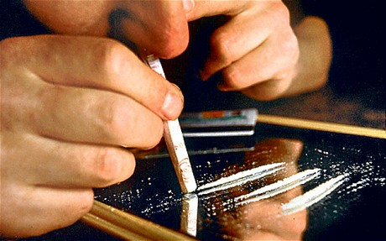
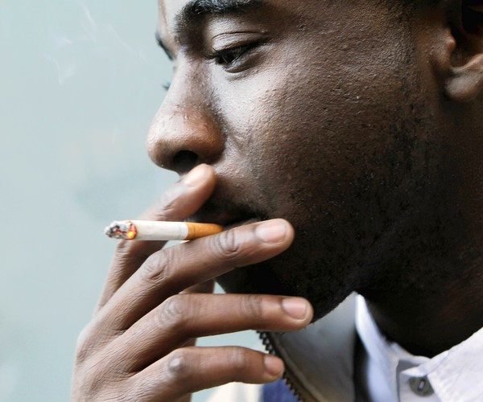
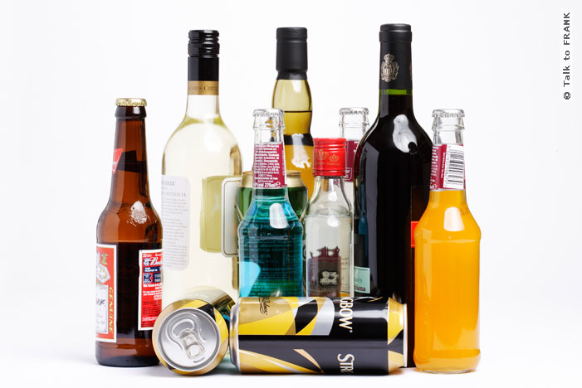
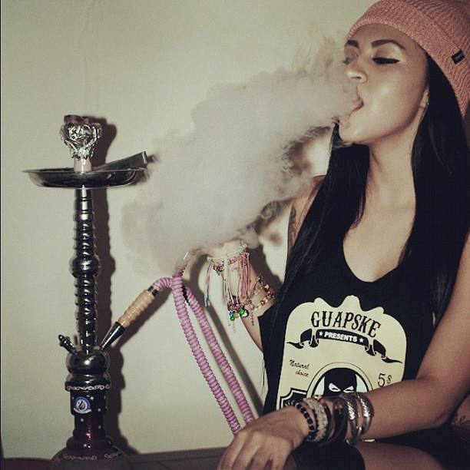
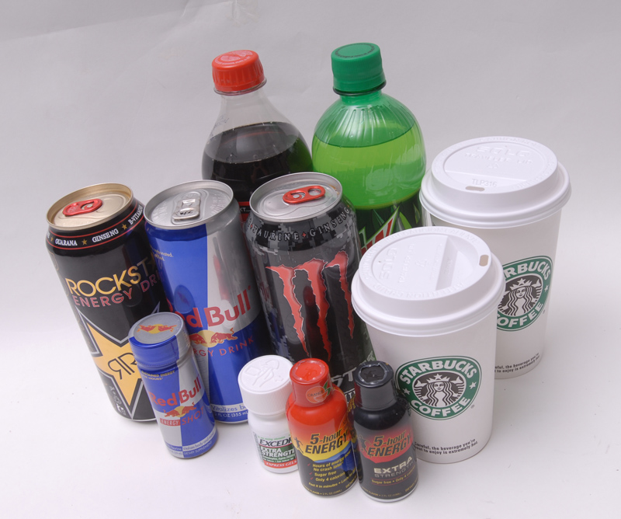
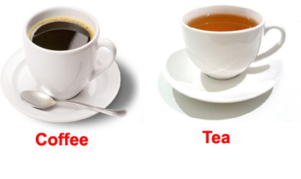
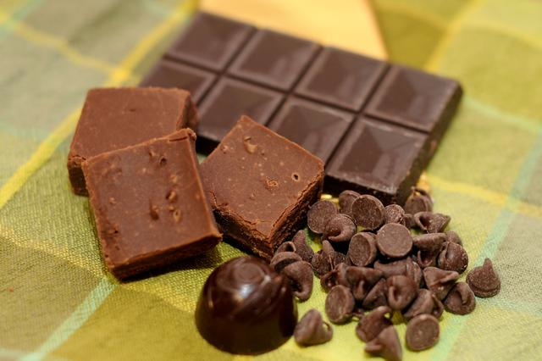
Substance Addictions
Drugs
Alcohol
Nicotine
Caffeine
Notes:
Drugs: Marijuana, Cocaine, Methamphetamines, Heroine, Prescription Drugs
Alcohol: Beer, Wine, Wine Coolers, Whiskey, Vodka, etc.
Nicotine: Cigarettes, E-Cigarettes, Cigars, Chewing Tobacco, Hookah (flavored nicotine vapors)
Caffeine: Coffee, Tea, Sodas, Energy Drinks (Monster, Red Bull), Chocolate, Energy Water (Vitamin Water, Fruit2O, Propel)

Slide 6
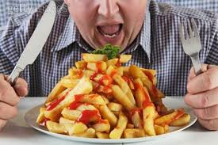
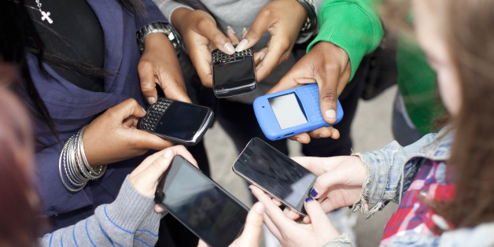
Behavioral Addictions
Pornography
Sex Addiction
Overeating or undereating
Gambling
Social Media
Work-a-holic
Gossiping
Jealousy

Slide 7
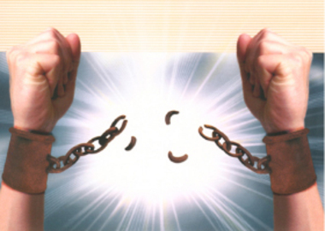
How to Break Chains of Addiction

Slide 8
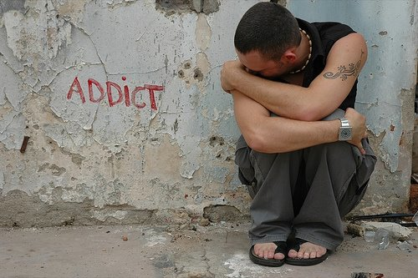
Recognize signs and symptoms
Obsessed/Can’t break the habit
Can’t stop habit despite health problems/takes risks
Disinterested in hobbies/sacrifices family-social activities
Never runs out of supplies
Need addiction to deal with problems
Secrecy/solitude
Denial
Problems with the law
Financial difficulties
Failing Relationships
Cravings, moody, bad temper, poor focus, depressed/empty, frustrations, anger, bitterness/resentment

Slide 9
Pray
Pray that your eyes may be opened
Pray for deliverance
Pray that God will take away the desire for the addiction
Pray for strength to resist and overcome the temptation

Slide 10
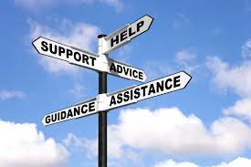
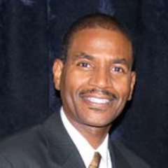
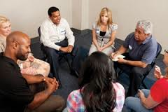
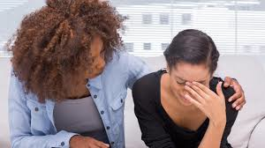
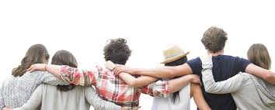
Seek Help
Pastors
Counselors
Bible Workers
Medical Professionals
Support Groups

Slide 11
Change
Change your friends
Change your environment/atmosphere
Get rid of your stashes
Develop positive habits
Change your lifestyle with a NEWSTART
MAKE A CLEAN BREAK!

Slide 12
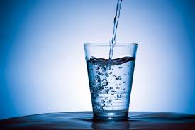
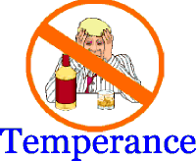
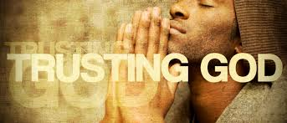
NEWSTART 8 Principles to a healthy lifestyle
N = Nutrition
E = Exercise
W= Water
S = Sunlight
T = Temperance
A = Air
R = Rest
T = Trust in God

Slide 13
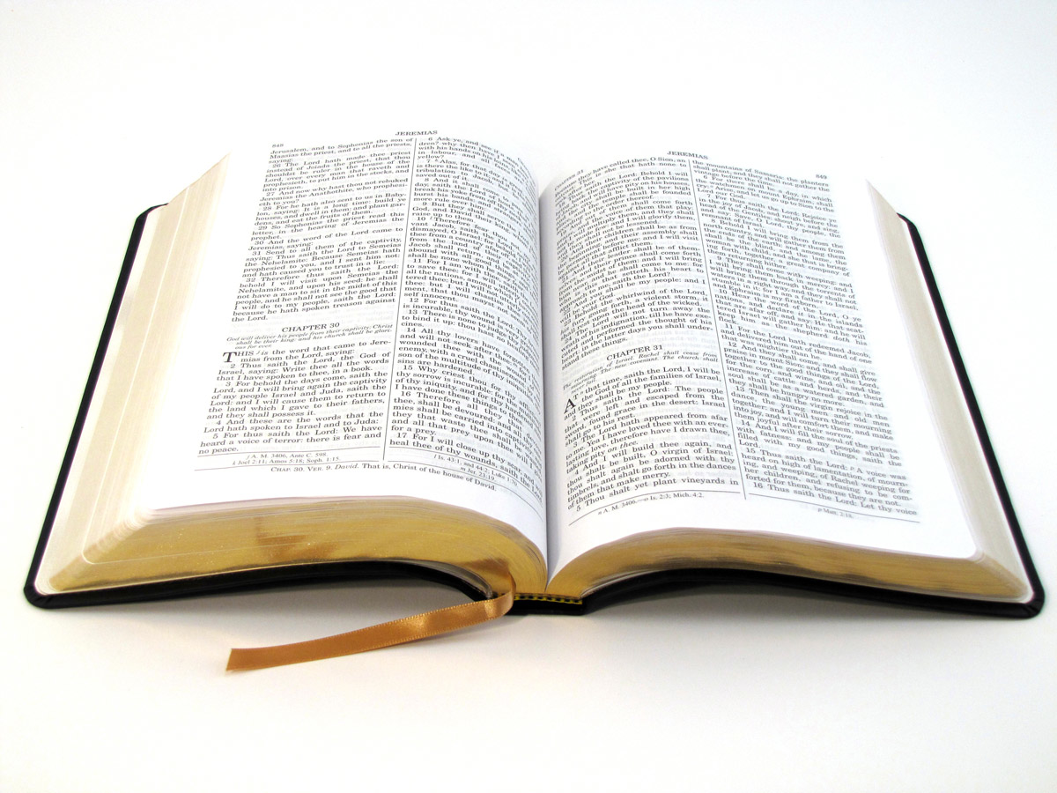
Remember God’s Word
1 Corinthians 6:19 Your body is temple of the Holy Spirit
Matthew 7:7 Ask, Seek and Knock
1 Corinthians 10:13 God is faithful to make a way of escape from temptation
Matthew 26:41 Watch and Pray to avoid temptation

